Slide 1

CHAPTER FIVE
OOP Concepts
By: Behayilu M.
Faculty of Computing and Software Engineering.,
Arba Minch Institute of Technology(AMiT),
Arba Minch University

Slide 2
Points to be covered on this chapter
Object oriented programming concepts
Encapsulation
Inheritance
Polymorphism
  Method overloading
  Method overriding
Abstraction
  Abstract class
  Interface

Slide 3
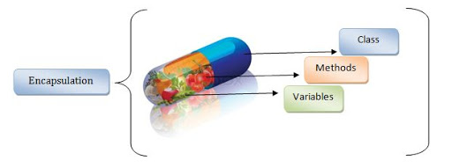
1. Encapsulation
There are four fundamental OOP concepts.
Encapsulation
Inheritance
Polymorphism
Abstraction
Encapsulation is a process of wrapping code and data together into a single unit, for example capsule i.e. mixed of several medicines.

Slide 4
…cont’d
It is the technique of making the fields in a class private and providing access to the fields via public methods.
If a field is declared private, it cannot be accessed by anyone outside the class, thereby hiding the fields within the class.
For this reason, encapsulation is also referred to as data hiding.
We can create a fully encapsulated class in java by making all the data members of the class private.
Now we can use setter and getter methods to set and get the data in it.

Slide 5
Advantage of encapsulation in java
The fields of a class can be made read-only or write-only.
A class can have total control over what is stored in its fields.
The users of a class do not know how the class stores its data.
A class can change the data type of a field and users of the class do not need to change any of their code.

Slide 6
class Student { private String name; private int age; private char sex; public void setName(String newName) { this.name=newName; } public String getName() { return this.name; } public void setAge(int newAge) { this.age=newAge; } public int getAge() { return this.age; } | public void setSex(char newSex) { this.sex=newSex; } public char getSex() { return this.sex; } }

Slide 7
public class RunEncap
{
public static void main(String args[])
{
Student s1 = new Student( ); s1.setName(“Hellen"); s1.setAge(20);
s1.setSex(‘F’);
System.out.println(s1.getName());
System.out.println(s1.getAge());
System.out.println(s1.getSex());
}
}

Slide 8
2. Inheritance
Inheritance is defined as the process where one object acquires the properties of another object.
In other words, the derived class inherits the states and behaviors from the base class.
The derived class is also called sub-class and the base class is also known as super class.
syntax
class DerivedClass extends BaseClass {
//methods and fields
}

Slide 9
…cont’d
With the use of inheritance the information is made manageable in a hierarchical order.
The extends keyword is used to determine whether one object IS - A type of another.
When we are using inheritance there is IS – A relationship.
IS-A is a way of saying : This object is a type of that object.
Why use inheritance in java
For code reusability
For method overriding (so run time polymorphism can be achieved)

Slide 10
…cont’d
Example to show how the extends achieve this.
public class Animal{
}
public class Mammal extends Animal{
}
public class Reptile extends Animal{
}
public class Dog extends Mammal{
}

Slide 11
…cont’d
Now, from the above example, if we consider the IS – A relationship, we can say:
Mammal is - A Animal.
Reptile is - A Animal.
Dog is A – Mammal.
Hence, Dog is Animal as well.
With use of the extends keyword the subclasses will be able to inherit all the properties of the super class except for the private properties of the super class.

Slide 12
Example
package a1;
class Employee{
protected float salary=4000.0f;
public void show( ) {
System.out.println(this.salary);
}
}
public class Programmer extends Employee{
int bonus=10000;
public void display( ) {
System.out.println(this.bonus);
}
public static void main(String args[]){
Programmer p=new Programmer();
p.show( );
p.display( );
}
}
4000.0
10000

Slide 13
Types of inheritance
On the basis of class, there can be three types of inheritance: single, multilevel and hierarchical in java.
Single inheritance: is when a class extends another one class.
Multi level inheritance: is when one can inherit from derived class, thereby making this derived class the base class for the new class.
Hierarchal inheritance: when one class is inherited by many classes.

Slide 14
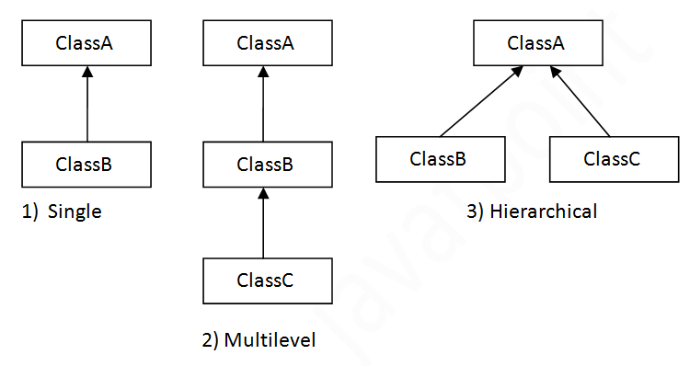
…cont’d
When a class extends multiple classes i.e. known as multiple inheritance.
Java supports only single inheritance.

Slide 15
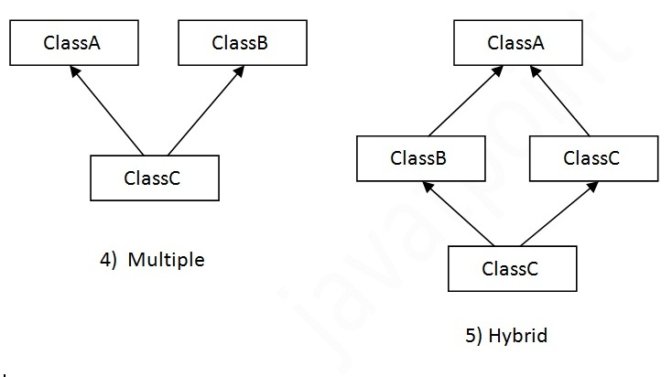

Slide 16
Single inheritance
class Animal{
void eat(){System.out.println("eating...");}
}
class Dog extends Animal{
void bark(){System.out.println("barking...");}
}
class TestInheritance1{
public static void main(String args[]){
Dog d=new Dog();
d.bark();
d.eat();
}
}
Multi level inheritance
class Animal{
void eat(){System.out.println("eating...");}
}
class Dog extends Animal{
void bark(){System.out.println("barking...");}
}
class BabyDog extends Dog{
void weep(){System.out.println("weeping...");}
}
public class TestInheritance2{
public static void main(String args[]){
BabyDog d=new BabyDog();
d.weep();
d.bark();
d.eat();
}
}
barking...
eating...
weeping...
barking...
eating...

Slide 17
Hierarchical Inheritance Example
class Animal{
void eat(){System.out.println("eating...");}
}
class Dog extends Animal{
void bark(){System.out.println("barking...");}
}
class Cat extends Animal{
void meow(){System.out.println("meowing...");}
}
public class TestInheritance3{
public static void main(String args[]){
Cat c=new Cat();
c.meow();
c.eat();
}}
Multiple inheritance is not supported in java
class A{
void msg(){System.out.println("Hello");
}
}
class B{
void msg(){System.out.println("Welcome");
}
}
class C extends A,B
{
public static void main(String args[])
{
C obj=new C();
obj.msg( );
}
}
meowing...
eating...
Compile Time Error

Slide 18
3. Polymorphism
Polymorphism in java is a concept by which we can perform a single action by different ways.
Polymorphism is derived from two Greek words: poly and morphs.
The word “poly” means many and “morphs” means forms.
So polymorphism means many forms.

Slide 19
There are two types of polymorphism in java:
Compile time polymorphism (Method Overloading).
Runtime polymorphism (Method Overriding).
We can perform polymorphism in java by method overloading and method overriding.
If you overload static method in java, it is the example of compile time polymorphism.
Here, we will focus on runtime polymorphism in java.

Slide 20
1. Method Overloading
If a class has multiple methods having same name but different in parameters, it is known as Method Overloading.
Advantage of Method overloading
If we have to perform only one operation, having same name of the methods increases the readability of the program.

Slide 21
There are two ways to overload the method in java.
By changing number of arguments
By changing the data type

Slide 22
Method overloading: changing no. of arguments
In this example, we are created two methods, first add( ) method performs addition of two numbers and second add( ) method performs addition of three numbers.
In this example, we are creating static methods so that we don’t need to create instance for calling methods.

Slide 23
public class Adder
{
public static int add(int a, int b)
{
return a+b;
}
public static int add(int a,int b,int c)
{
return a+b+c;
}
public static void main(String args[])
{
System.out.println(add(3,4));
System.out.println(add(4,5,6));
}
}
7
15

Slide 24
Method Overloading: changing data type of arguments
In this example, we have created two methods that differs in data type.
The first add method receives two integer arguments and second add method receives two double arguments.

Slide 25
public class Adder
{
public static int add(int a, int b)
{
return a+b;
}
public static double add(double a, double b)
{
return a+b;
}
public static void main(String args[])
{
System.out.println(add(3,4));
System.out.println(add(2.4,8.6));
}
}
7
11.0

Slide 26
2. Method Overriding
Run time polymorphism (Method Overriding) is a process in which a call to an overridden method is resolved at runtime rather than compile time.
In this process, an overridden method is called through the reference variable of a super class.
The determination of the method to be called is based on the object being referred to by the reference variable.

Slide 27
Example of java runtime polymorphism
In this example, we are creating two classes Vehicle and Bike.
Bike class extends vehicle class and overrides its run method( ).
We are calling the run method by the reference variable of parent class.

Slide 28
…cont’d
Since it refers to the subclass object and subclass method overrides the parent class method, sub class method is invoked at runtime.
Since method invocation is determined by the JVM not compiler, it is known runtime polymorphism.
Which methods cannot be overridden in Java?
Static methods :- static methods can not be overridden in java
Final methods :- which are those that the parent class has declared with the ‘final’ keyword

Slide 29
class Vehicle
{
public void run( ){
System.out.println(“Vehicle is running”);
}
}
class Bike extends Vehicle{
public void run( ){
System.out.println(“Bike is running”
}}
public class MainClass
{
public static void man(String args[])
{
Vehicle v=new Bike( );
v.run( );
}
}
Bike is running

Slide 30
4. Abstraction
Abstraction is a process of hiding the implementation details and showing only functionality to the user.
Another way, it shows only important things to the user and hides the internal details. For example sending sms, you just type the text and send the message.
Data abstraction provides the outside world with only essential information, in a process of representing essential features without including implementation details
In java, abstraction is achieved using abstract classes and interfaces.

Slide 31
Abstract class
A class that is declared with abstract keyword , is known as abstract class in java.
Abstraction refers to the ability to make a class abstract in OOP.
It can have abstract and non-abstract methods (method with body).
An abstract class is one that cannot be instantiated.

Slide 32
…cont’d
All other functionality of the class still exists, and its fields, methods, and constructors are all accessed in the same manner.
You just cannot create an instance of the abstract class.
If a class is abstract and cannot be instantiated, the class does not have much use unless it is super class.
The abstract keyword is used to declare abstract class in java.

Slide 33
Abstract method
If you want a class to contain a particular method but you want the actual implementation of that method to be determined by child classes, you can declare the method in the parent class as abstract.
The abstract keyword is also used to declare a method as abstract.
An abstract method consists of a method signature, but no method body.

Slide 34
…cont’d
Abstract method would have no definition, and its signature is followed by a semicolon, not curly braces.
If a class contains an abstract method, the class must be abstract as well.
Any child class must either override the abstract method or declare itself abstract.
A child class that inherits an abstract method must override it.
If they do not, they must be abstract and any of their children must override it.

Slide 35
Example
package pack;
public abstract class Bank
{
public void deposit()
{
System.out.println("common deposit method across all banks...");
}
public void withdraw()
{
System.out.println("common withdraw method across all banks...");
}
public abstract float interest();
}
public class Dashen extends Bank
{
public float interest()
{
System.out.println("Dashen bank interest implimentetion...");
return 0.0f;
}
}
public class Wegagen extends Bank
{
public float interest()
{
System.out.println("Wegagen bank interest implimentetion...");
return 0.0f;
}
}

Slide 36
public class Demo {
public static void main(String args[])
{
Bank d=new Dashen();
d.deposit();
d.withdraw();
d.interest();
Bank w=new Wegagen();
w.deposit();
w.withdraw();
w.interest();
}
}
common deposit method across all banks...
common withdraw method across all banks...
Dashen bank interest implimentetion...
common deposit method across all banks...
common withdraw method across all banks...
Wegagen bank interest implimentetion...

Slide 37
Interface
An interface is a collection of abstract methods.
A class implements an interface, thereby inheriting the abstract methods of the interface.
A class describes the attributes and behaviors of an object.
An interface contains behaviors that a class implements.

Slide 38
…cont’d
The purpose of an interface is to specify behavior for a class.
In other words, we can say that interface is a design contract.
It specifies methods and classes can implement the interface and thereby sign the contract.

Slide 39
…cont’d
Differences and similarity between abstract class and interface
You can not instantiate an interface.
An interface does not contain any constructor.
All of the methods in an interface are abstract.
An interface can not contain instance fields.
The only fields that can appear in an interface must be both static and final.
A class can implement more than one interface at a time.

Slide 40
Declaring interface
The interface keyword is used to declare an interface.
A class uses the implements keyword to implement an interface.
By default all methods in interface are public and abstract.
interface interfaceName{
// declare constant fields
// declare abstract method
}

Slide 41
Example
package pack;
interface Animal {
public abstract void run();
public abstract void eat();
}
class Dog implements Animal{
@Override
public void run() {
System.out.println("Dogs can run");
}
@Override
public void eat() {
System.out.println("Dogs can eat too");
}
}
public class Demo
{
public static void main(String args[])
{
Animal animal=new Dog();
animal.run();
animal.eat();
}
}
Dogs can run
Dogs can eat too

Slide 42
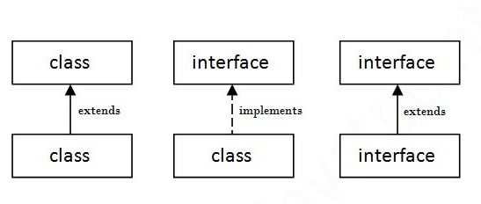
The relationship between classes and interfaces
As shown in the figure given below, a class extends another class, an interface extends another interface, but a class implements an interface.

Slide 43
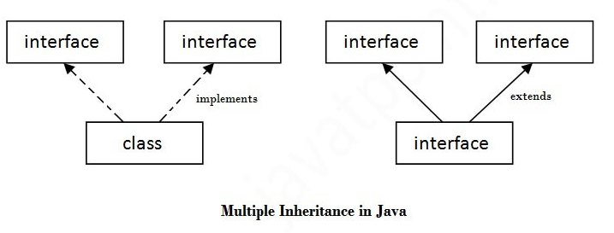
Multiple inheritance in Java by interface
If a class implements multiple interfaces, or an interface extends multiple interfaces, it is known as multiple inheritance.

Slide 44
Multiple inheritance in Java by interface
package pack;
interface Printable{
void print( );
}
interface Showable{
void show( );
}
public class A implements Printable, Showable{
public void print( ){System.out.println("Hello");}
public void show( ){System.out.println("Welcome");}
public static void main(String args[]){
A obj = new A();
obj.print();
obj.show();
}
}
Hello
Welcome

Slide 45
Interface inheritance
A class implements an interface, but one interface extends another interface.
interface Printable{
void print( );
}
interface Showable extends Printable{
void show( );
}
public class TestInterface implements Showable{
public void print( ){System.out.println("Hello");}
public void show( ){System.out.println("Welcome");}
public static void main(String args[]){
TestInterface obj = new TestInterface( );
obj.print( );
obj.show( );
}
}
Hello
Welcome

